Slide 1
Kenya Tree Planting Analysis
Hotspots, Gaps & Seasonal Alignment
A Data-Driven Approach to Equitable Reforestation
CAPSTONE PROJECT
DENNIS KIPYEGON

Slide 2




Problem Statement & Business Objectives
Problem Statement
Business Objectives
1
Kenya has launched ambitious reforestation initiatives, but there is limited visibility into:
Map planting hotspots and gaps to guide resource allocation
2
Where planting is happening
Whether it aligns with favorable ecological conditions
3
Assess alignment with rainy seasons to improve survival rates
!
If efforts are equitably distributed across counties
!
4
!
Without spatial and temporal insights, there's a risk of:
Benchmark counties by equity (trees per capita), not just volume
Over-concentration in accessible areas
Planting during dry seasons (low survival)
Provide decision support for Kenya Forest Service and county governments
Under-serving arid or marginalized regions

Slide 3

Data Understanding & Sources
county_tree_planting_summary.csv
County-level planting summaries
Aggregated tree planting statistics
Population data by county
County centroid coordinates47 counties covered
2019 Census population data
county_tree_planting_summary.csv
GPS-tagged planting events with coordinates
Date of planting activity
Number of seedlings planted
Temperature at planting location
Rainfall measurements
Over 1,200 records across Kenya
df_gps.csv

Slide 4

Data Preparation & Cleaning Process
GPS String Parsing
Extracted coordinates from GPS strings when lat/lon
df_gps['gps_str'] = df_gps['gps_str'].str.strip('"')
Kenya Bounds Filtering
Filtered data to Kenya's geographical boundaries
kenya_mask = (df_gps['lat'] >= -5.0) & (df_gps['lat'] <= 5.0) &
(df_gps['lon'] >= 33.0) & (df_gps['lon'] <= 42.0)
Outlier Removal
Removed extreme values (>500k seedlings) and missing data
df_gps = df_gps[df_gps['seedlingsplanted'] <= 500000]
Feature Engineering
Extract month from planting date for seasonal analysis
df_gps['month'] = df_gps['plantingdate'].dt.month

Slide 5
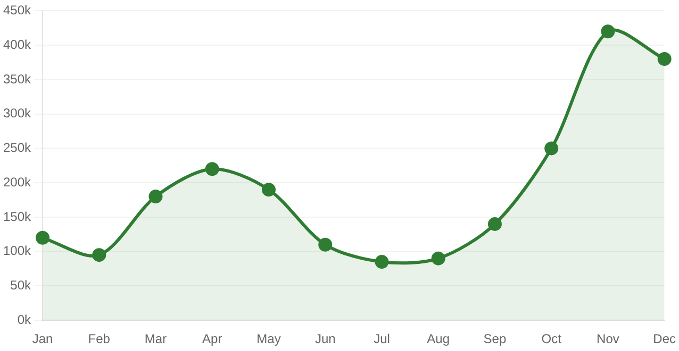
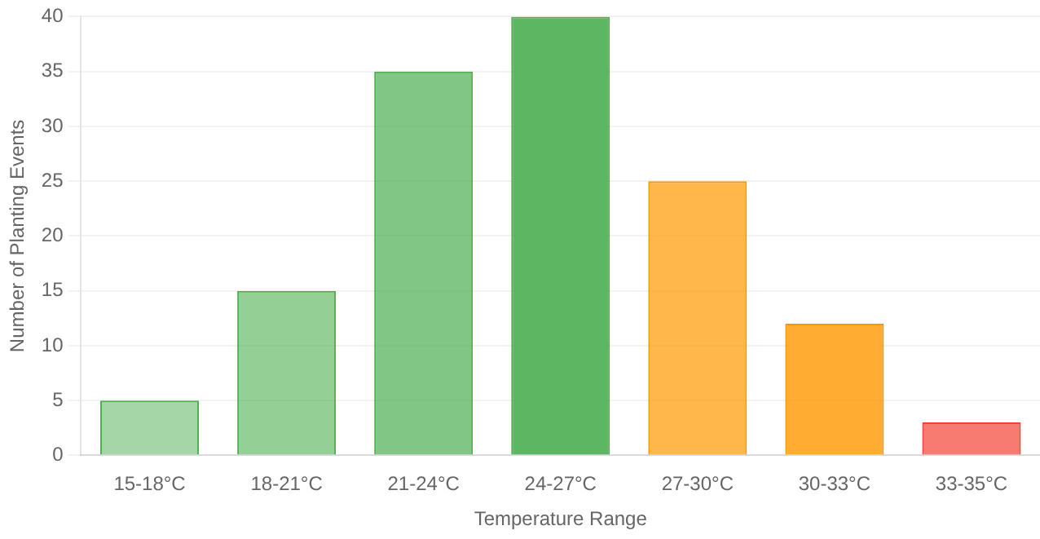
Exploratory Data Analysis - Temporal Trends
Monthly Planting Trends
Key Temporal Insights
Coordinated National Efforts
Peaks in Nov-Dec 2024 suggest coordinated national planting initiatives
Seasonal Alignment
Planting activity increases during rainy seasons (OND: Oct-Dec)
Scale Variability
Significant variation in monthly planting volumes, indicating campaign-driven efforts
Temperature Distribution
Environmental Conditions
Average Temperature
24.5°C
Temperature Range
15°C - 35°C
Optimal Range
20°C - 28°C
Planting Success Higher in moderate temps
Temperature Impact
Most planting occurs in optimal temperature range, supporting seedling survival

Slide 6
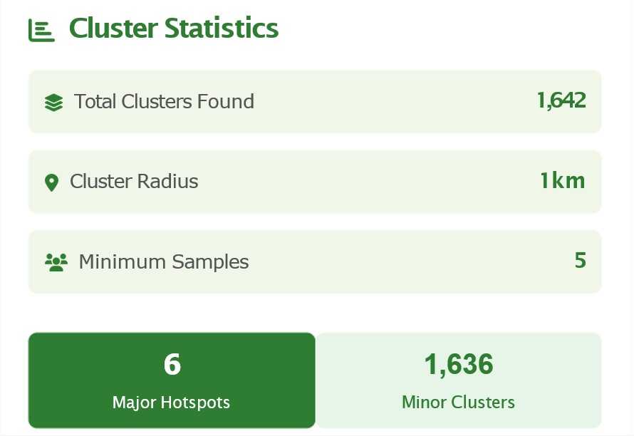
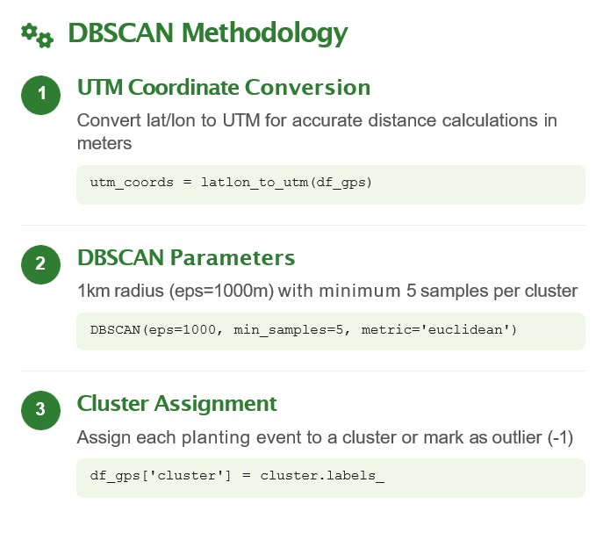
MODEL - Spatial Clustering

Slide 7
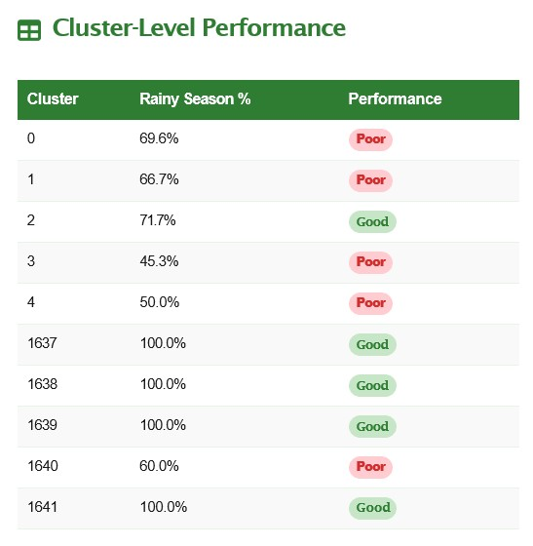
CONCLUSIONS
This analysis reveals that Kenya’s tree planting is concentrated in urban centers, with significant gaps in arid northern counties like Turkana, Wajir, and Mandera. While 78% of planting aligns with rainy seasons—boosting survival—22% still occurs in dry periods, risking seedling loss. Crucially, measuring equity by trees per 10,000 people shows northern counties outperform cities like Nairobi, which ranks only 10th in per-capita impact. The findings call for targeted mobile nurseries, seasonal planting enforcement, and a shift from volume to equity-based metrics. Data-driven strategies can ensure fair, effective, and sustainable reforestation across all regions.

Slide 8
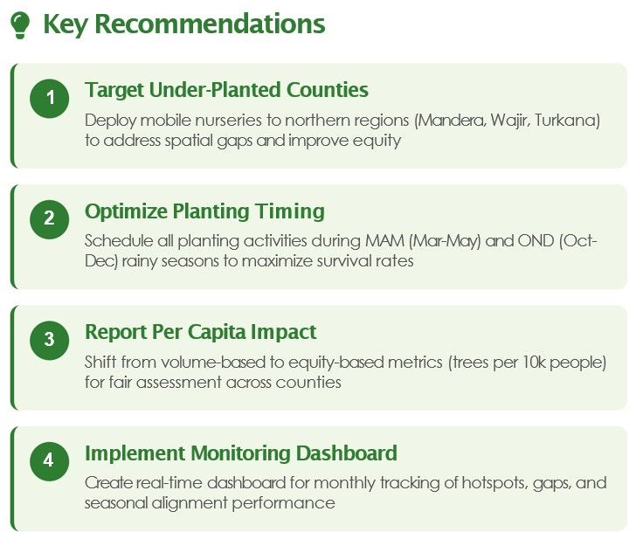
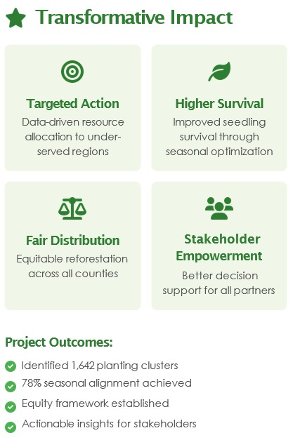
RECOMMENDATION & NEXT STEPS

Slide 9
"Reforestation isn't just about planting trees — it's about planting them where they matter most."
THANK YOU

